Slide 1

CAPSTONE PROJECT
Sentiment Analysis of Product Reviews
CSA1706 - ARTIFICIAL INTELLIGENCE
PRESENTED BY:
CH. VENKATA NAVANEETH (192311211)
TL BHUVANESH (192311021)
K.GOWTHAM (192372078)
UNDER THE SUPERVISION OF:
Dr.Krishna Kumar Kathiresan

Slide 2
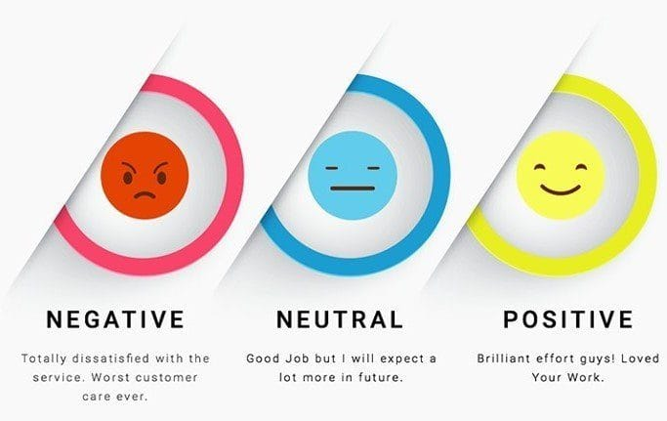
INTRODUCTION
Customers give reviews after purchasing products.
These reviews contain useful information about customer opinions.
Companies may receive a large number of reviews.
Reading all reviews manually takes a lot of time.
Our system automatically analyzes these reviews.
It classifies them as Positive, Neutral, or Negative.

Slide 3

PROBLEM STATEMENT
Companies have many customer reviews, but it is difficult to:
Analyze every review manually.
Understand customer satisfaction quickly.
Identify products with low ratings.
Find common customer complaints.

Slide 4
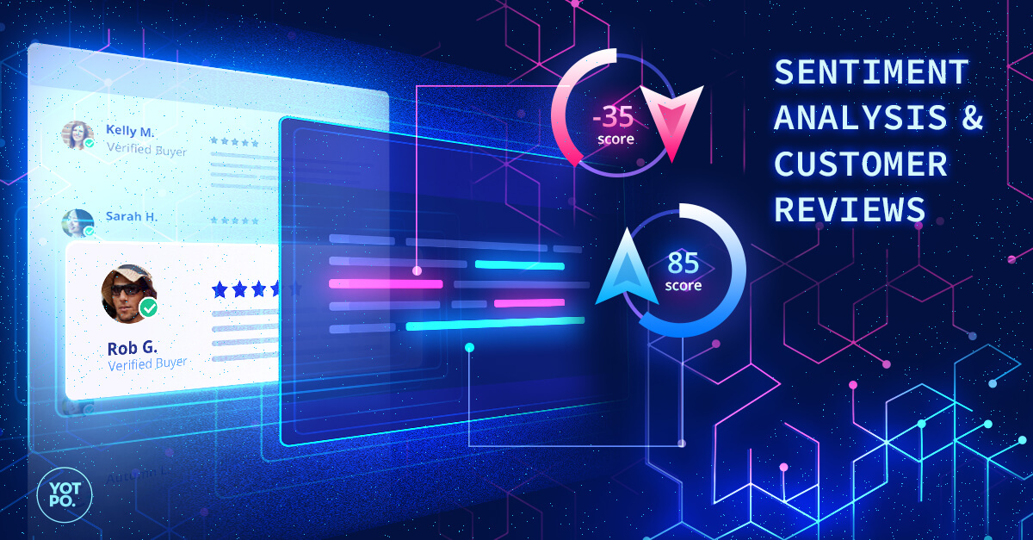
OBJECTIVES
Analyze customer product reviews.
Perform product-wise analysis.
Calculate average product ratings.
Classify reviews as Positive, Neutral and Negative.
Identify common negative keywords.
Analyze customer dissatisfaction.
Provide useful insights for product improvement.

Slide 5
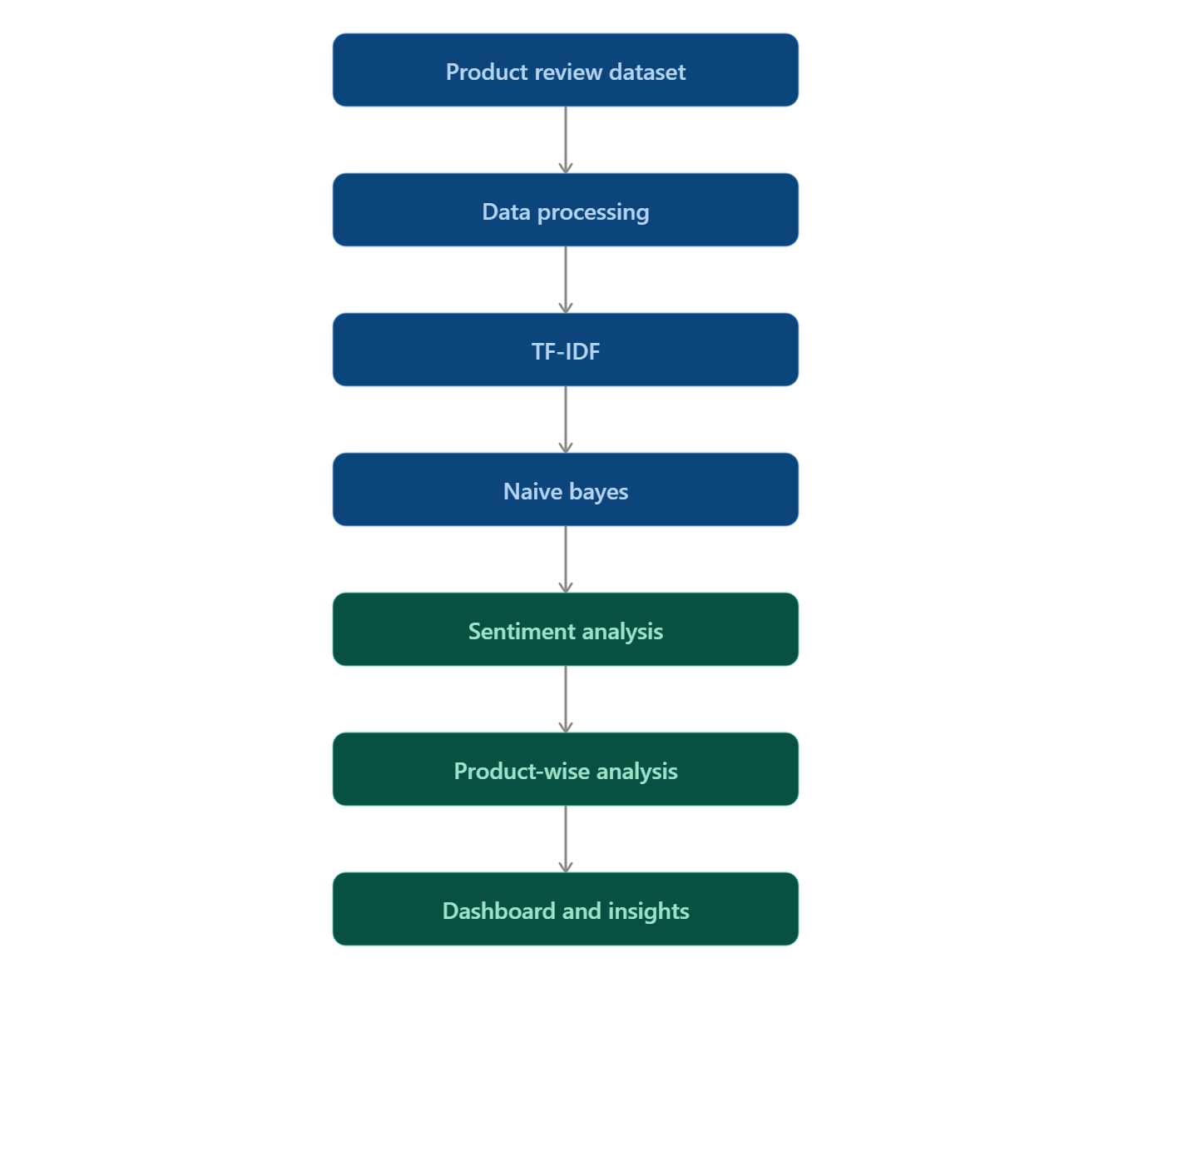
SYSTEM WORK FLOW
Collect Product Reviews
Preprocess the Review Data
Convert Review Text into Features
Apply Naive Bayes Model
Classify Reviews as Positive, Neutral, or Negative
Select a Specific Product for Analysis
Calculate Product Rating and Sentiment
Identify Common Negative Keywords
Display Results through Dashboard
Generate Insights for Product Improvement

Slide 6
MODULES
Product Analysis Module
Sentiment Prediction Module
Dashboard & Insights Module

Slide 7
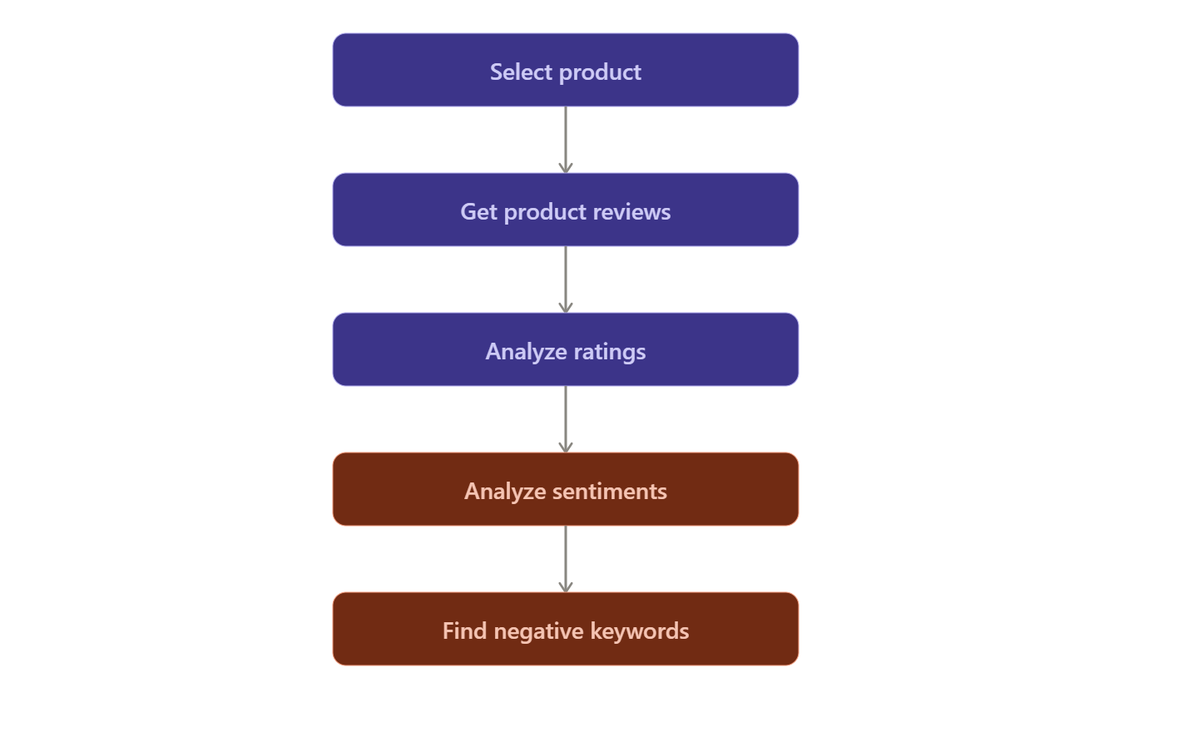
MODULE 1 - Product Analysis Module
Select a product.
Analyze its reviews and ratings.
Calculate Positive, Neutral, and Negative percentages.
Identify common negative keywords.
Find products with customer dissatisfaction.

Slide 8
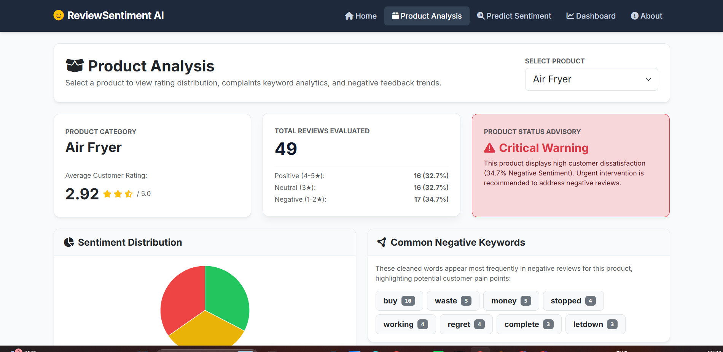

Slide 9
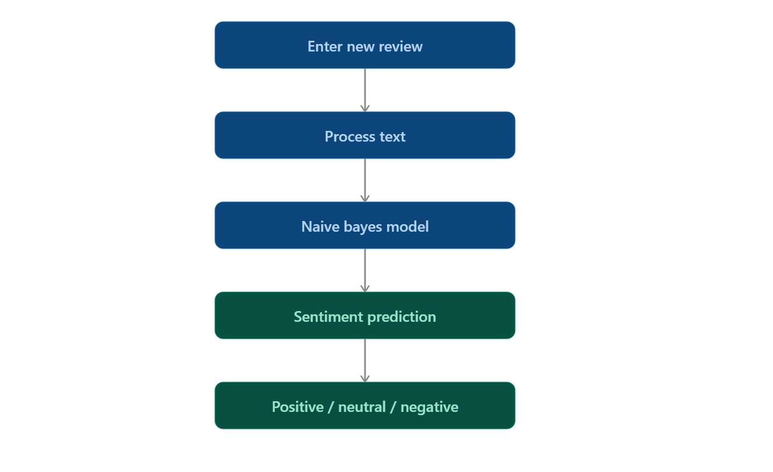
MODULE 2 - Sentiment Prediction Module
Enter a new product review.
Process the review using the trained model.
Predict the sentiment as Positive, Neutral, or Negative.
Display the prediction result.

Slide 10
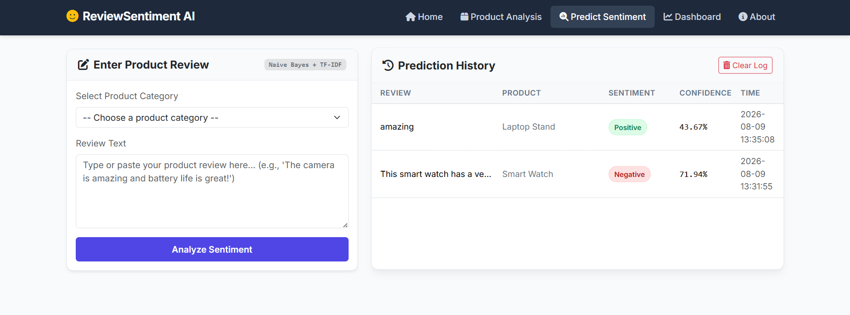

Slide 11
MODULE 3 - Dashboard & Insights Module
Display overall review statistics.
Show sentiment distribution using charts.
Display product-wise results.
Highlight negative feedback and common complaints.
Provide insights that can help in product improvement.

Slide 12
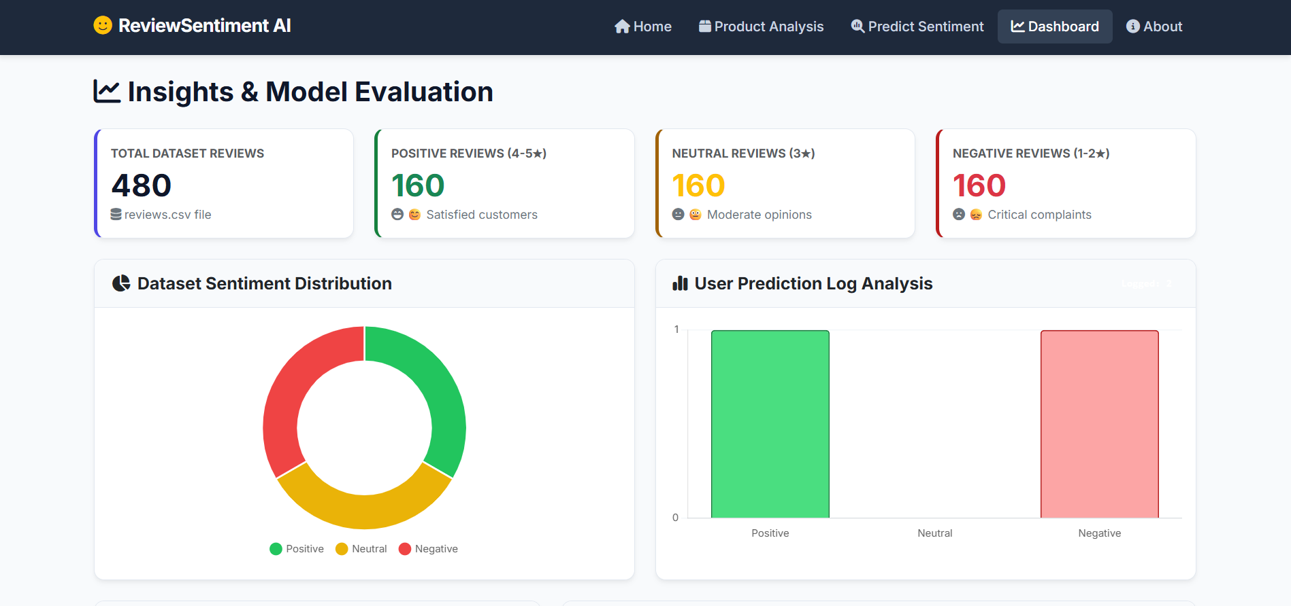

Slide 13
RESULTS
The system successfully analyzes product reviews.
Reviews are classified into Positive, Neutral, and Negative sentiments.
Product-wise analysis shows total reviews, average rating, and sentiment percentages.
Common negative keywords help identify customer complaints.
The dashboard presents the results in an easy-to-understand way.
The system helps identify products with higher customer dissatisfaction.
The analysis can support companies in making product improvement decisions.

Slide 14
CONCLUSION
The project provides an automated way to analyze customer product reviews.
It reduces the effort required for manual review analysis.
Naive Bayes is used to classify review sentiments.
Product-wise analysis helps understand customer satisfaction.
Negative reviews and common complaints provide useful insights for product improvement.
Overall, the system makes customer feedback analysis faster and easier.

Slide 15
FUTURE SCOPE
Add real-time review collection from online platforms.
Support a larger number of products and reviews.
Add aspect-based sentiment analysis to identify problems such as price, quality, battery, and performance.
Improve sentiment prediction accuracy using advanced ML/deep learning models.
Add multilingual review analysis.
Provide more detailed product improvement recommendations.

Slide 16
REFERENCES
A. K. Singh, S. Sharma, and R. Kumar, Sentiment Analysis of Product Reviews Using Machine Learning Techniques, 2023.
M. S. Alharbi and A. Stevenson, Deep Learning Approaches for Sentiment Analysis of Customer Reviews, 2023.
S. Minaee, A. Kalchbrenner, E. Cambria, N. Nikzad, M. Chenaghlu, and J. Gao, Deep Learning-Based Text Classification: A Comprehensive Review, 2023.
A. Yadav and D. Vishwakarma, Sentiment Analysis Using Machine Learning and Deep Learning Techniques: A Review, 2023.
A. K. Rai, P. Kumar, and S. Gupta, Machine Learning Based Sentiment Analysis of Online Product Reviews, 2024.

Slide 17


